Slide 1
TABU SEARCH METHOD

Slide 2
1. How the program works
-Initialization
-Structure of the algorythm
-Evaluation Function
-Succesor Function

Slide 3
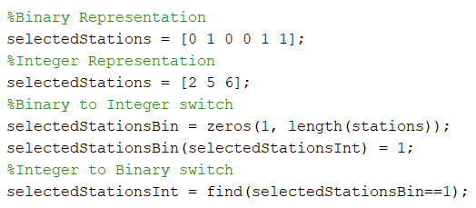
1.1- Initialization
Mostly the usual: satellite data + Tabu Search data
TabuList holds a cell per every station
Integer representation of representative stations.
Not much difference between binary or integer.

Slide 4
1.2- Structure of the algorythm
Very similar to the generic Tabu Search structure.
Matrix of succesors has two extra columns: the value of the succesor, the change from the parent.
Stopping conditions are a total maximum and a maximum without improvement: 500, 20.
Parent 1 | 2 | 5 | Value 138.42 | Change -
3 | 2 | 5 | 141.23 | 3
1 | 7 | 5 | 156.75 | 7
1 | 2 | 6 | 137.89 | 6

Slide 5
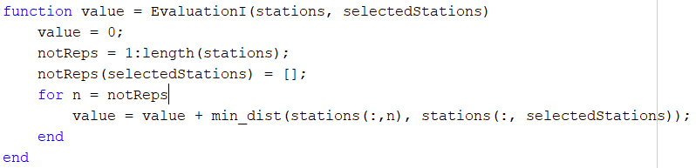
1.3- Evaluation Function
Standard method: get all the not-representative stations, then add the distances of each to its closest representative.
This is basic, we shouldn’t need to show it…

Slide 6
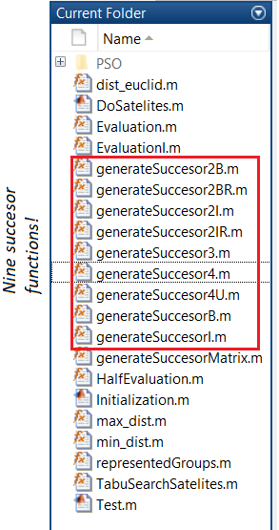
1.4- Succesor function
* Requires a varLevel parameter, determines the n-th selected station to be altered.
We tried different methods to replace the n-th selected:
By the next one in the array
By its closest station
By the furthest station represented by it.
By the station closest to the mean point of all of its group of represented stations.

Slide 7
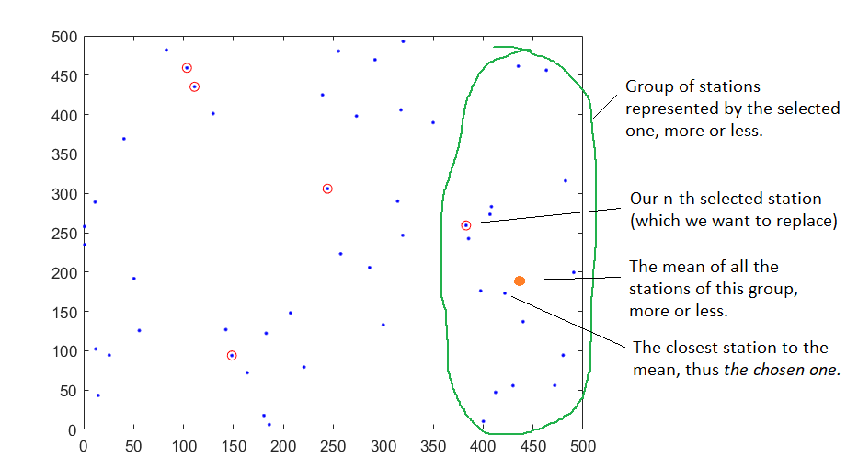
In the end, the 4th method proved best, by a decent margin.

Slide 8
2. Choices of implementation

Slide 9
2.1- Why integer, not binary representation?
In the end, both had extremely similar efficiencies when tested.
(Plus we can switch between them with ease)
So, this didn’t have a big impact on the overall efficiency.
Integer used less memory, and it was easier to use with the following…

Slide 10
2.2- Auxiliar array: “represented”
Length: N (500).
In position n, stores the station that represents n.
If n is a representative, stores a 0.
Representatives | 3 | 6 | 8
Represented | 3 | 8 | 0 | 6 | 6 | …

Slide 11
2.2.1- why is this array useful?
Both the evaluation and the succesor function use these “groups of represented”.
Tests lead to the evaluation function being ~20 times faster with this array.
Succesor function went from 2*10e-3 to 4*10e-6.
500 times faster!!

Slide 12
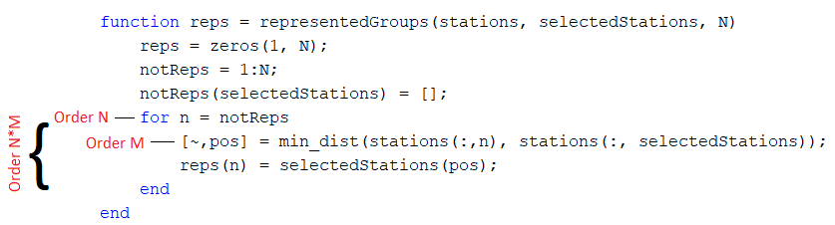
2.2.2- There are drawbacks…
To create this auxiliar array we call the function: “representedGroups”.
This function is very costly, order of N*M.
A call to this function plus either evaluation or succesor completely negates all improvement…

Slide 13
We tried “updating” the array
Instead of creating a new array whenever needed, we tried just creating the initial one.
Then, we would update it for each succesor.
But that proved impossible.

Slide 14
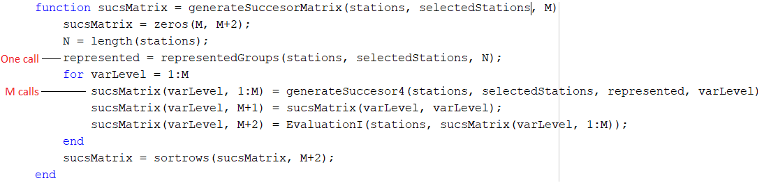
Solution: minimize the calls to the function
The succesor function needs the represented array of the father.
1 father -> M succesors.
We can’t save the evaluation function, it stays inefficient :(

Slide 15
3.- conclusions of tabu Search
It’s relatively quick! We optimized every operation as much as possible.
Total of iterations remain low. For 500 stations it finishes in under 100!
Often gets good results: ~1.35 e4
*Possible drawback? Results might become worse with low number of stations, due to the succesor method.
But we couldn’t really confirm it.

